Slide 1


John O. Agumba
agumba.john @gmail.com
LinkedIn: www.linkedin.com/in/john-agumba-jakobura
Popularity of Content Categories

Slide 2


Today's agenda
Project recap
Problem
The Analytics team
Process
Insights
Summary

Slide 3

The Project analyzes the popularity of the contents and highlights the top 5 categories with the largest aggregate popularity
Project Recap

Slide 4
An audit of the big data practice
An analysis of the content categories that highlights the top 5 categories with the largest aggregate popularity
Recommendations for a successful IPO
Problem

Slide 5




The Analytics team

Slide 6
Extraction of sample data
sets using SQL
Process
1
Cleaning the data sets
2
3
Merging of sample data set tables
4
Data analysis and Visualization
5
Sharing the insights with team

Slide 7
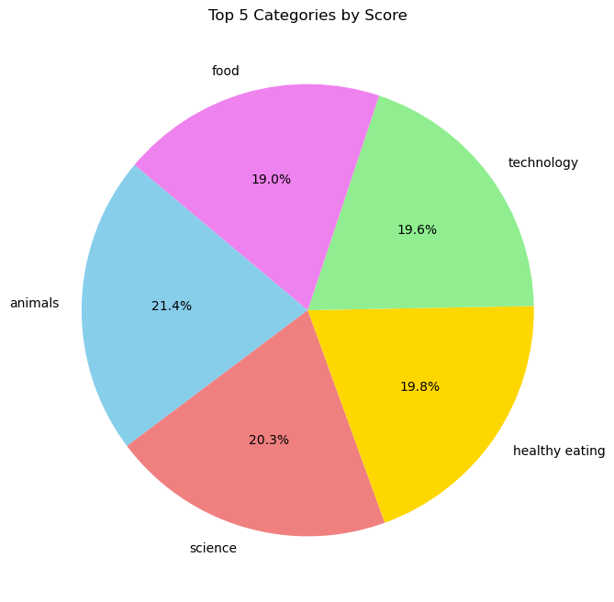

Insights
Category | Score
animals | 74965
science | 71168
healthy eating | 69339
technology | 68738
food | 66676

Slide 8
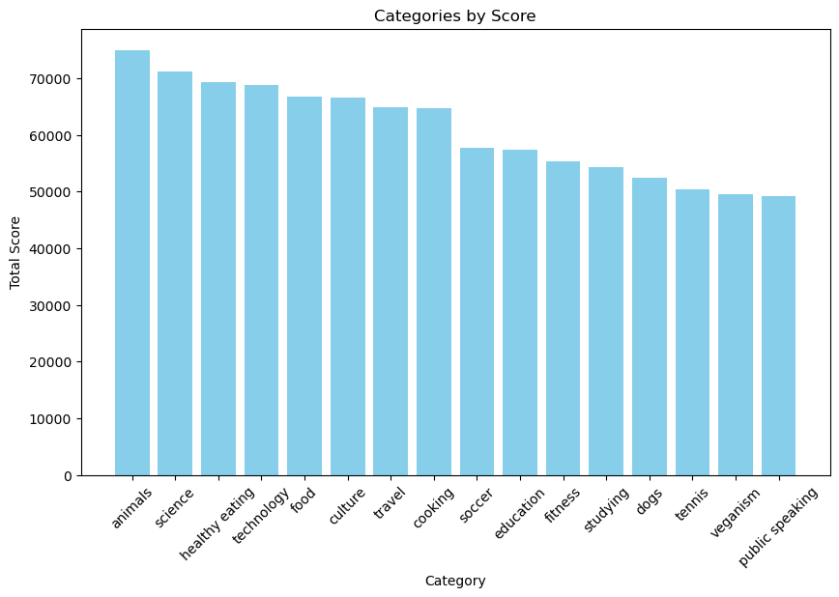
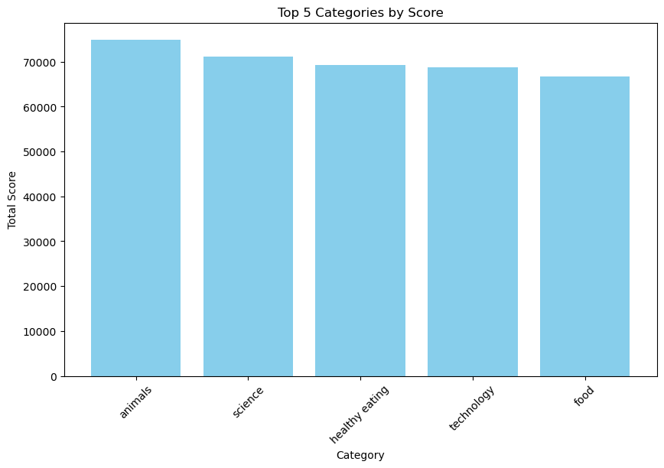

Slide 9
No | Category
1 | Animals
2 | Cooking
3 | Culture
4 | Dogs
5 | Education
6 | Fitness
7 | Food
8 | Healthy eating
9 | Public speaking
10 | Science
11 | Soccer
12 | Studying
13 | Technology
14 | Tennis
15 | Travel
16 | Veganism
Categories=16

Slide 10
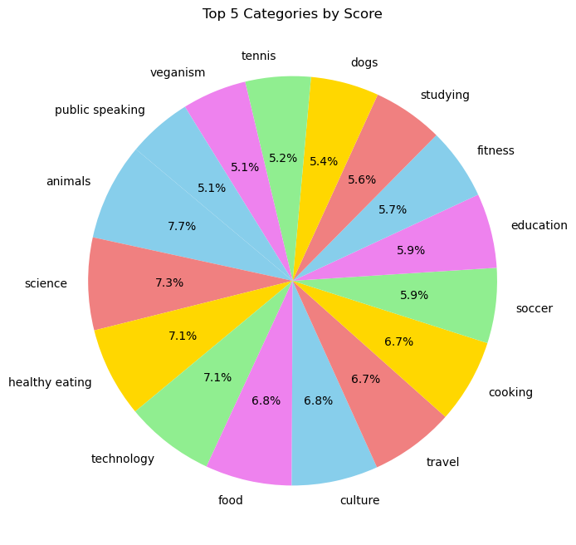
No | Category
May | 2138
Jan | 2126
Aug | 2114
Dec | 2092
July | 2070
Oct | 2056
Nov | 2034
Sep | 2022
Jun | 2021
Mar | 2012
Apr | 1974
Feb | 1914
Month with the most posts=May

Slide 11
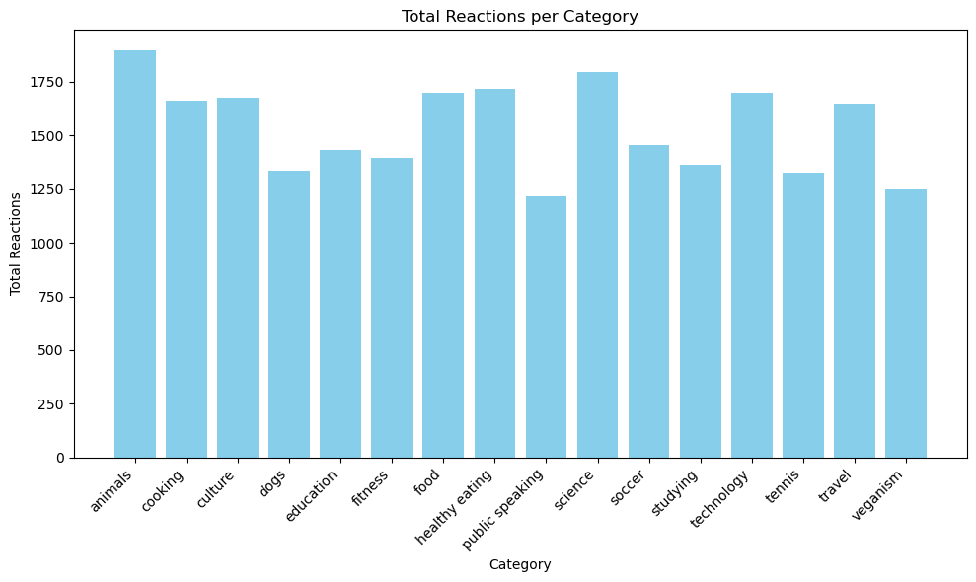
Category with Highest Reactions
Animals-1,897

Slide 12

Top 5 most popular categories are animals, science, healthy eating, technology & food
Summary
Category with highest reactions is Animals
The number of unique categories 16
Month with the most posts is May

Slide 13
Thank you!
ANY QUESTIONS?

